Slide 1


Jonathan R. Cervas
University of California Irvine
The Terminology
of Districting
Prepared for
jcervas@uci.edu
www.jonathancervas.com
@cervasj
Capitol Forum - Redistricting Post-Conference, Phoenix AZ December 12, 2019

Slide 2
Ordering of Criteria
Districting criteria can be ranked in their legal importance in terms of how courts treat compliance with them.
Criteria of the highest order are those which are constitutionally mandated as a matter of federal law, such as the “one person, one vote” standard, and the requirement that race not be the “preponderant motive” in line drawing.
Next would come compliance with federal statutes such as the Voting Rights Act.
Next come criteria that are found in state constitutions.
Finally, the rest come from statute and common practice

Slide 3
Focus of this panel
In this panel, we focus on the criteria that a legislature either may be constrained by state law or may choose among on principle of `good governance’
I will begin by giving some definitions of some traditional redistricting criteria
I will finish my brief presentation and introduce my fellow panelist and open it up for discussion

Slide 4
Traditional Criteria
Highest Order (mandated)
Contiguity - refers to the drawing of districts whose parts are geographically connected with one another, i.e., not divided into multiple disconnected pieces. (how do we deal with issues like water contiguity)
One person, one vote - population equality across districts (the courts have long held that districts must contain the same number of persons, regardless of voter turnout or voter eligibility)
Race as preponderant motive – Race can not be used as the dominant criteria (multiple cases in the 2010 round of redistricting were struck down by SCOTUS based on this criteria)

Slide 5
Traditional Criteria
Lower Order (may or may not be mandatory)
Integrity of county and city boundaries – minimizing the number of political sub-division splits
Preservation of District Cores – Avoiding drawing districts that dramatically reconfigure the prior maps
Compactness - degree of irregularity in the border of a district, or to the degree to which the district borders are not close to the geographic center of the district
Fracking - Fracking occurs when population from given county or city is found in two or more discontiguous pieces within the same district

Slide 6
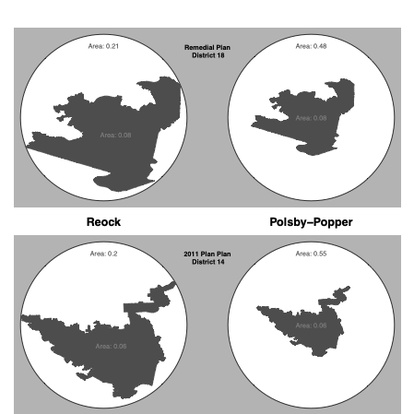
Compactness

Slide 7
Traditional Criteria
Lower Order (may or may not be mandatory)
Integrity of county and city boundaries – minimizing the number of political sub-division splits
Preservation of District Cores – Avoiding drawing districts that dramatically reconfigure the prior maps
Compactness - degree of irregularity in the border of a district, or to the degree to which the district borders are not close to the geographic center of the district
Fracking - Fracking occurs when population from given county or city is found in two or more discontiguous pieces within the same district

Slide 8
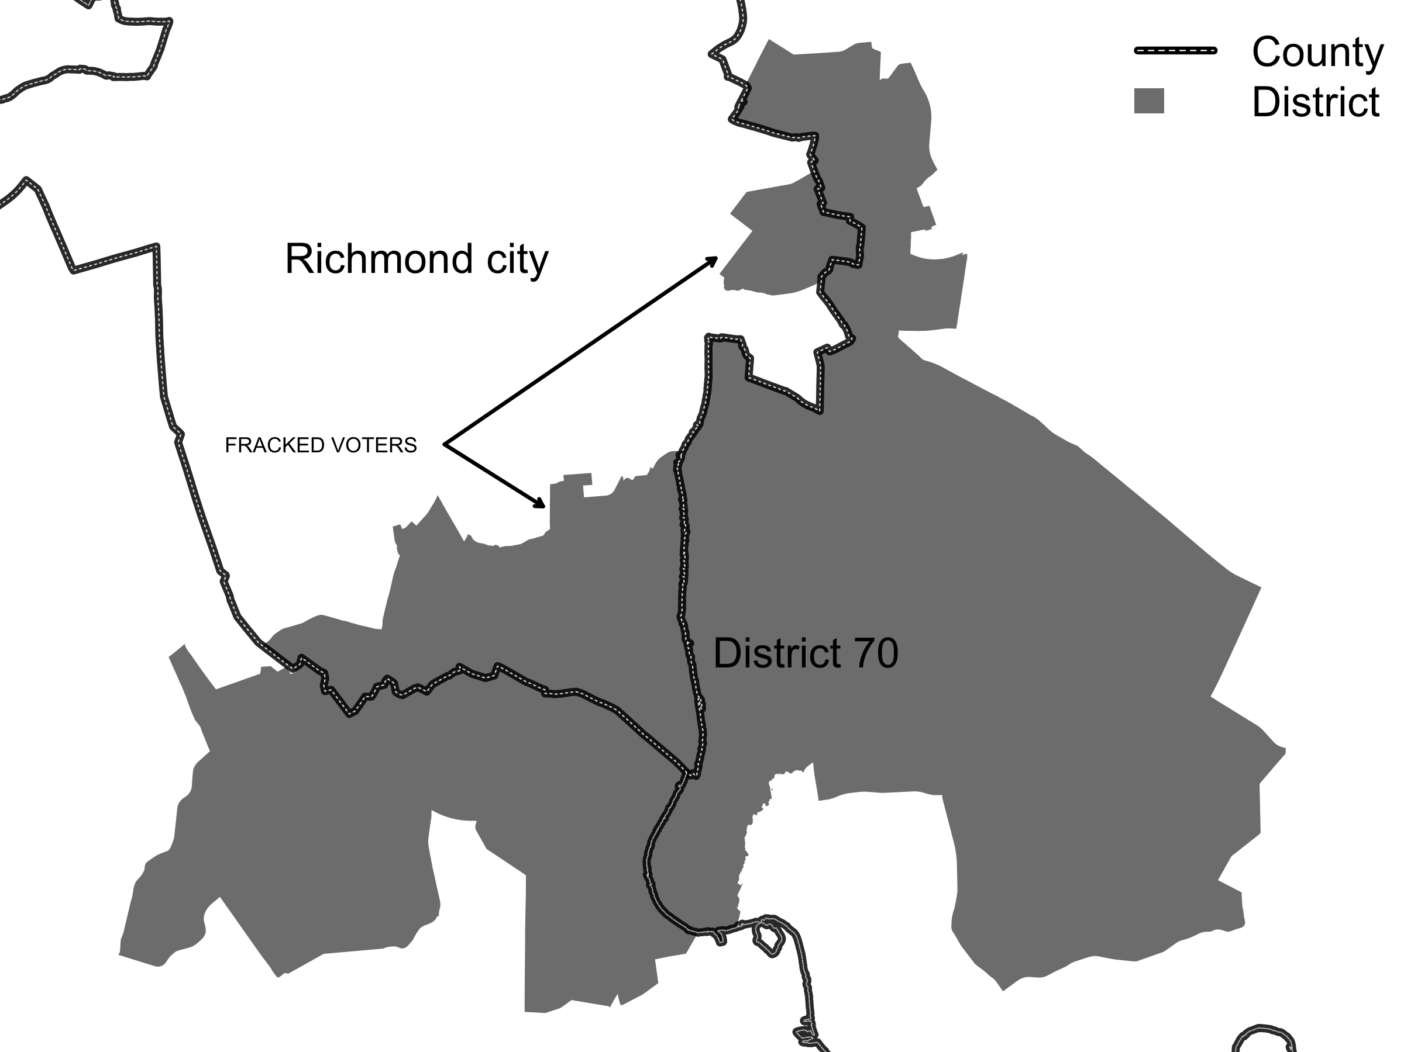
Fracking

Slide 9
Traditional Criteria
Lowest Order (unlikely to be mandatory)
Incumbent Pairings - to the greatest extent feasible, incumbent homes should remain in a district with the same number
Competitiveness - creation of competitive districts where there is no significant detriment to other goals (Ariz.)
Prohibiting Partisan data - No apportionment plan or individual district shall be drawn with the intent to favor or disfavor a political party or an incumbent (FLA. CONST. art. III, § 20(a))

Slide 10
Traditional Criteria
Lowest Order (unlikely to be mandatory)
Preserve Communities of Interest – Communities of interest (however they are defined) should remain in one entire district, when applicable
Proportionality/Symmetry - Districts must be drawn in ways that seek to achieve either particular outcomes or political opportunities

Slide 11
Traditional Criteria
Other Terms
Stealth Gerrymander - is a plan that satisfies traditional districting criteria to a considerable extent but still minimizes/dilutes the voting strength on the less favored group.
Dummymander - arises when the party doing the line-drawing has cut the margins too thin in many districts (and relies overmuch on the power of incumbency advantage) so that, if there is an electoral tide favoring the other party, there can be a dramatic reversal in party fortunes.

Slide 12
Traditional Criteria
Other Terms
Cracking - involves dispersal of a group’s electoral strength so as to dilute the group’s political power. Districts that have been cracked are ones where voters of one partisan or racial or ethnic group have had their share of the district’s electorate reduced so as to make it impossible (or unlikely) that candidates preferred by this group will be able to win the district.
Packing - involves concentrating a group’s electoral strength so as to dilute the group’s political power. Districts that have been packed are those which have had voters from one partisan or racial or ethnic group grouped together in the district in such a fashion that the group’s candidate of choice wins the district by an overwhelming majority. Packing ``wastes'' votes of the group and costs them potential victories in other districts.

Slide 13
Conclusions
The UpShot from this exercise is that the lines matter! Sometimes even unintentional decisions can lead to sub-optimal, or perhaps even unconstitutional outcomes.
Let’s meet our Panelists!

Slide 14
Kathay Feng
National Redistricting Director for Common Cause
Leads Common Cause’s work to challenge partisan and incumbent gerrymandering,
Kathay is the architect of California’s Citizens Redistricting Commission
She also led efforts that secured passage of California laws bringing online voter registration and same day registration (called conditional voter registration) to the state.

Slide 15
Rep. Tyler Vorpagel
Represents the 27th Assembly District of Wisconsin
Received a Bachelor's Degrees in Public Administration and Political Science
Most recently served as District Director for Congressman Tom Petri
Worked with numerous state, county, and community leaders across Wisconsin and throughout Sheboygan and Manitowoc Counties
Chairs the Federalism and Interstate Relations committee
Serves on the Children and Families, Energy and Utilities, International Affairs and Commerce, State Affairs, and Transportation Committees

Slide 16


jcervas@uci.edu
kfeng@commoncause.org
Rep.Vorpagel@legis.wisconsin.gov
cervasj
kathayccc
repvorpagel
Jonathan
Cervas
Kathey
Feng
Rep.
Vorpagel

Slide 17
Common Cause has been involved with some high profile court cases (see Common Cause v. Lewis, N.C 2019) -- going into the next decade of redistricting, especially now that Section 5 preclearance is no longer a constraint, and SCOTUS non-judiciable ruling in Rucho (2019), how do you expect states to respond? Should we expect more or less litigation after 2021?
Notes:
For Kathey

Slide 18
Wisconsin was the subject of much litigation this decade -- going into 2021, how does the modern era of litigation impact decisions legislators make when balancing different criteria?
Notes:
For Tyler

Slide 19
How much weight should the legislature give communities of interest/how should they be determined/ranked in importance. what input should the public have in constructing these communities?

Slide 20
Some criteria run into conflict with others, such as maintaining political sub-divisions and compactness; what criterion should be given the highest priority, and what happens if certain traditional criteria lead to partisan/racial gerrymanders (stealth gerrymanders)?

Slide 21
Other than the traditional criteria, there are some newer criteria that states have begun adopting in recent decades. These include things like requiring that districts be competitive, prohibitions on drawing districts to favor or disfavor incumbents, parties, or candidates, or prohibiting the use of partisan data in redistricting. In your opinion, is it a good idea for states to adopt these criteria? Do you believe more states will adopt them in the future?

Slide 22
How much deference should be given to incumbents in the districting process? Are incumbent protection/maintaining district cores worthy goals in terms of creating good governance?

Slide 23
Increasing the competitiveness is sometimes have been a goal of redistricting commission or even statutes -- some alternatively have argued that competitive districts are bad for America (Redistricting and Representation: How Competitive Elections are Bad for Democracy New York: Routledge (2008).) Should legislatures favor competitive districts, competitive chambers, some form of proportionality (including non-competitive districts), or ignore partisan politics altogether?

Slide 24
Jonathan R. Cervas
University of California Irvine
The Terminology
of Districting
Prepared for
Capitol Forum - Redistricting Post-Conference, Phoenix AZ December 12, 2019

Slide 25
Types of Gerrymanders
Gerrymanders come in multiple forms, some partisan, some racial, some intentional, some accidental, and yet others naturally.
Let’s show a few…

Slide 26

49 Total Voters – 7 Districts
Orange and Purple vote 100% with their party, gray votes 50% of the time for either Orange or Purple.
Voter matrix draw randomly
Districts must have equal population (7 persons).
 | Votes | Seats
 | 20 (41%)
 | 23 (47%)
 | 6 (12%)
Gray seats are those that the undecided voters cast the pivotal vote

Slide 27
Majoritarian Principle – Competitive (w/ no bias)
Neutrally drawn with compact boundaries. The majority party wins 3, the minority party wins 2, one competitive district is favored by purple and one favors the orange party
 | Votes | Seats
 | 20 (41%) | 2
 | 23 (47%) | 3
 | 6 (12%) | 2
Gray seats are those that the undecided voters cast the pivotal vote

Slide 28
Anti-Majoritarian – Not Competitive (w/ bias)
Plan is drawn to maximize the total number of seats for the minority party. It is not possible for them to get more than 5/7.
 | Votes | Seats
 | 20 (41%) | 5
 | 23 (47%) | 2
 | 6 (12%) | 0
Gray seats are those that the undecided voters cast the pivotal vote

Slide 29
Egregious Gerrymander – Low responsiveness (w/ bias)
This plan maximizes the majority party’s seat share. Given the concentration of purple voters on the right, it is unavoidable that they win at least one seat. (Perhaps the one virtue of being ‘naturally’ packed)
 | Votes | Seats
 | 20 (41%) | 1
 | 23 (47%) | 5
 | 6 (12%) | 1
Gray seats are those that the undecided voters cast the pivotal vote

Slide 30
Highly Competitive (w/ no bias)
This plan is drawn to maximize competitiveness, with unaffiliated voters deciding 6/7 contests.
 | Votes | Seats
 | 20 (41%) | 0
 | 23 (47%) | 1
 | 6 (12%) | 6
Gray seats are those that the undecided voters cast the pivotal vote

Slide 31
Neutral Plan (vertical – responsive but slightly bias)
49 Total Voters – 7 Districts
Orange and Purple vote 100% with their party, gray votes 50% of the time for either Orange or Purple
 | Votes | Seats
 | 20 (41%) | 1
 | 23 (47%) | 3
 | 6 (12%) | 3
Gray seats are those that the undecided voters cast the pivotal vote

Slide 32
Neutral Plan (horizonal w/ no bias)
49 Total Voters – 7 Districts
Orange and Purple vote 100% with their party, gray votes 50% of the time for either Orange or Purple
 | Votes | Seats
 | 20 (41%) | 3
 | 23 (47%) | 3
 | 6 (12%) | 1
Gray seats are those that the undecided voters cast the pivotal vote

Slide 33
Anti-Majoritarian – Not Competitive (w/ bias)
Not neutrally drawn and relatively ill-compact districts. Minority party wins the majority of the seats, and none are competive.
 | Votes | Seats
 | 20 (41%) | 4
 | 23 (47%) | 3
 | 6 (12%) | 0
Gray seats are those that the undecided voters cast the pivotal vote

Slide 34
Neutral Plan (w/ bias)
49 Total Voters – 7 Districts
Orange and Purple vote 100% with their party, gray votes 50% of the time for either Orange or Purple
 | Votes | Seats
 | 20 (41%) | 3
 | 23 (47%) | 3
 | 6 (12%) | 1
Gray seats are those that the undecided voters cast the pivotal vote

